Slide 1
ConnectiCare Presentation of Plans January 22, 2025
Email: jstairs@connecticare.com Phone: 860-447-5627 Fax: 860-674-2849
Jenifer Stairs
Provider Network Account Manager

Slide 2
Provider Quick Reference Guide
The following slides are shared resources and links to navigate the common questions regarding the ConnectiCare and Emblem Health family of plans

Slide 3
Provider Tool Kit
Where to find resources, documents, and additional support to help you provide exceptional patient care
https://www.connecticare.com/providers/resources/provider-toolkit
Find Our Most Current Updates
Keep Your Directory Information Current
2025 Summary of Companies, Lines of Business, Networks & Benefit Plans
2024 Summary of Companies, Lines of Business, Networks & Benefit Plans - Updated 7/22/2024
Access, Availability & After-Hours Coverage Standards
Laboratory Benefit Management Program - Provider Training Guide

Slide 4
Provider Customer Service Phone Numbers
Commercial:
800-828-3407
Medicare:
877-224-8230
For Credentialing Status Updates Please Call
866-610-8514

Slide 5
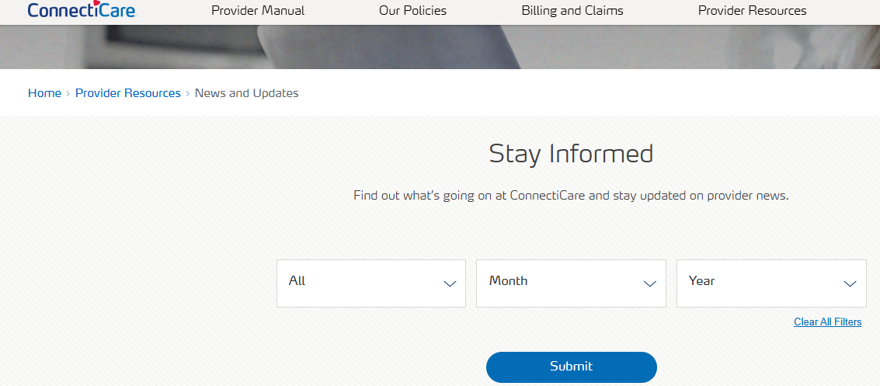
Where to Find Our Provider Newsletters https://www.connecticare.com/providers/resources/news
It is important to note that our provider newsletters contain essential information that includes
Policy changes, and Important notices
Both are very important to your practice and patients. Be aware that ConnectiCare will not provide this important information by any other means.

Slide 6
Sign up for Free EFT/ERA for Fast and Convenient Transactions
Through ECHO Health, Inc., you can receive direct deposits to your bank account(s) (known as electronic funds transfer (EFT)) and view or download your remittances online (known as electronic remittance advice (ERA)). Electronic transactions are fast, convenient, and reduce the risk of lost or stolen payments. This solution is free and allows you to reduce payment processing costs and improve cash flow. Visit ECHO, and then click on the “Click Here” button and follow the instructions to enroll.
https://enrollments.echohealthinc.com/EFTERAInvitation.aspx?tp=MDAxODY=

Slide 7
Request a Provider Portal Account, Provider Portal Training Materials, FAQs This is a great resource to quickly access claims and provider information Please note that all authorizations for ConnectiCare are only accepted via the portal
Please click on this link: Provider Portal Registration Form https://www.connecticare.com/providers/resources/provider-sign-in
1
Then click on “Request Provider Portal Account”
2
This link will take you to our provider portal training materials: https://www.connecticare.com/providers/resources/provider-toolkit/portal-training-materials
3
This link will take you to our provider portal FAQs: https://www.connecticare.com/providers/provider-portal-faq
4

Slide 8
Summary of ConnectiCare Processes
For information please click on this link: https://www.connecticare.com/content/dam/connecticare/pdfs/providers/resources/toolkit/resources/CCI-Medicare-PA-List-by-Category-and-CPT-Code-for-Online-Provider-Manual.pdf
How to Submit Preauthorization Requests
It is important to note that all preauthorization requests must be submitted through our provider portal.
This link will take you to instructions on how to submit a preauthorization request via ConnectiCare’s provider portal: Scroll down
Creating a Preauthorization Request. n until you find the header “Preauthorization”

Slide 9
ConnectiCare Prior Authorization Process
For information please click on this link: https://www.connecticare.com/content/dam/connecticare/pdfs/providers/resources/toolkit/resources/CCI-Medicare-PA-List-by-Category-and-CPT-Code-for-Online-Provider-Manual.pdf
How to Submit Preauthorization Requests
It is important to note that all preauthorization requests must be submitted through our provider portal.
This link will take you to instructions on how to submit a preauthorization request via ConnectiCare’s provider portal: Creating a Preauthorization Request. Scroll down until you find the header “Preauthorization”

Slide 10
ConnectiCare’s Claims Timely Filing Limits
Commercial Claims: 180 days from the date of service
Submitting Claims Electronically
For information, please click on this link:
Using the Provider Portal to Search for Explanation of Payments
For information, please click on this link: Explanation of Payments. Scroll down until you find the header “Claims”
Medicare Advantage Claims: 180 days from the date of service
Electronic Data Interchange Information
Claims

Slide 11
Appeals
Commercial Provider Appeals
For information, please click on this link: Commercial Provider Appeals, and scroll down to “Provider Appeals”
Medicare Advantage Provider Appeals
Commercial Provider Appeals
For information, please click on this link: Commercial Provider Appeals, and scroll down to “Provider Appeals”
For information, please click on this link: Medicare Advantage Provider Appeals, click on “Medicare” and scroll down to “Provider Appeals”

Slide 12
Add a Provider to Your Practice
Please click on this link, Provider Credentialing Form, complete the form and email it to CCICredentialing@ConnectiCare.com
Remove a Provider from Your Practice
Please click on this link, Provider Information Update Form, complete the form and email it to: CCICredentialing@ConnectiCare.com
Submit Provider Demographic Changes
Please click on this link, Provider Demographic Change Form, complete the form and email it to providerfileoperations@connecticare.com
Credentialing
Note: We utilize the CAQH for our credentialing. Please ensure that your provider files are up to date to align with your submission

