Slide 1
Baycare Health Partners
Ashley Farmer
Lisa Fico
Meg Costello
Dec. 2024

Slide 2
Agenda
About Point32Health
Online tools
Billing and reimbursement
News & updates
Resources

Slide 3
About Point32Health

Slide 4
Our family of brands

Slide 5


Our product portfolio
Tufts Health Plan commercial members are migrating to Harvard Pilgrim commercial plans
Tufts Health Public Plans
Tufts Health Senior Products
Commercial
Commercial

Slide 6
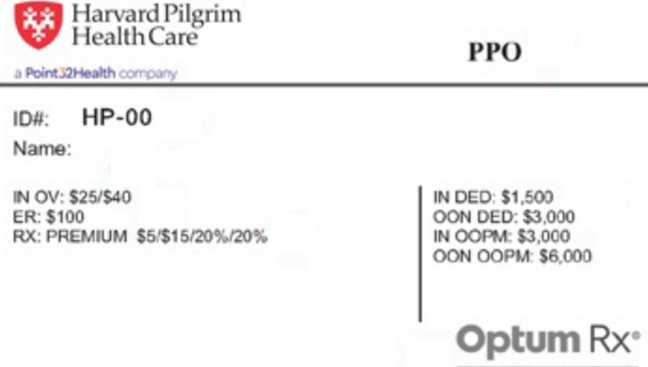
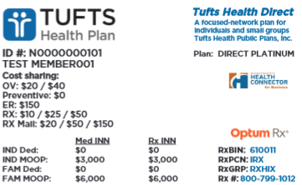

Member ID cards
Member ID cards includes product and claims information
Verify the latest member eligibility and benefits electronically via our provider portals or NEHEN

Slide 7
Online tools

Slide 8


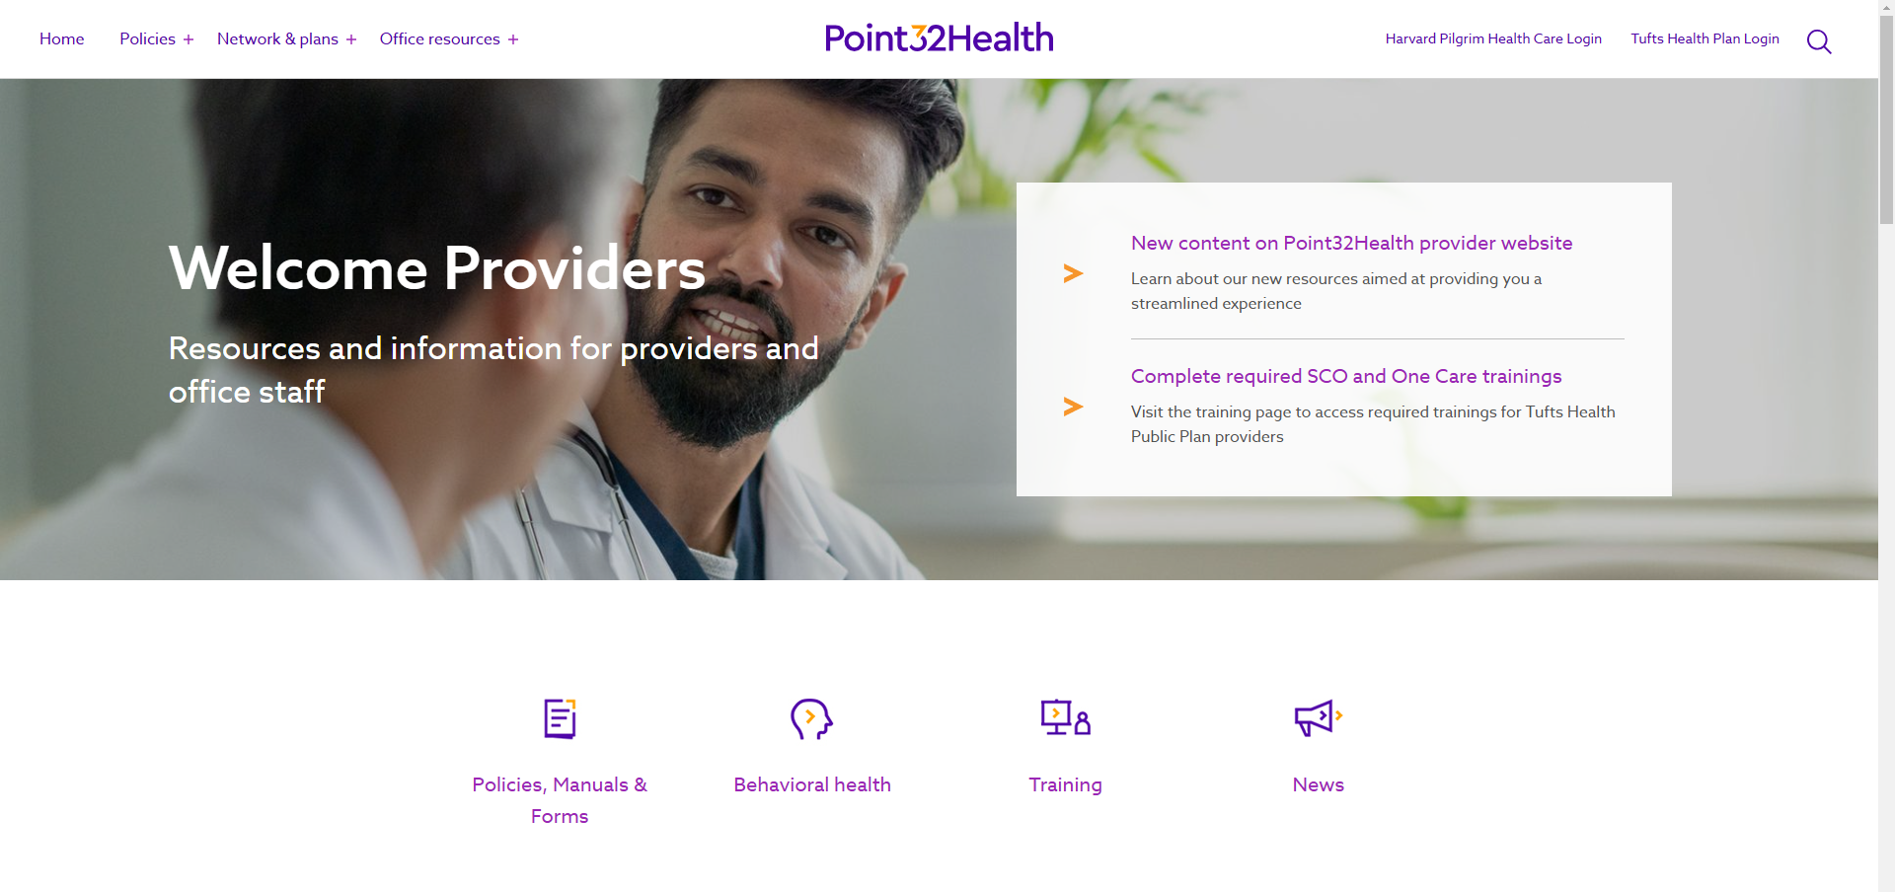
Point32Health provider website
point32health.org/provider
Log in to our Provider Portals
Navigate the website from the top Menu Bar
Important news and updates are highlighted
Use the Quick Navigation for easy access to the top resources

Slide 9
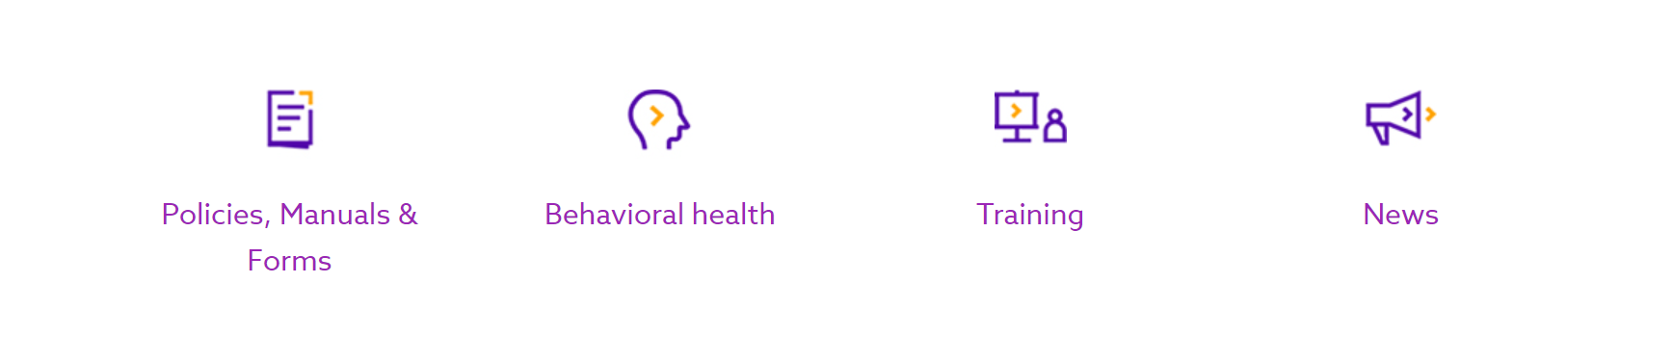
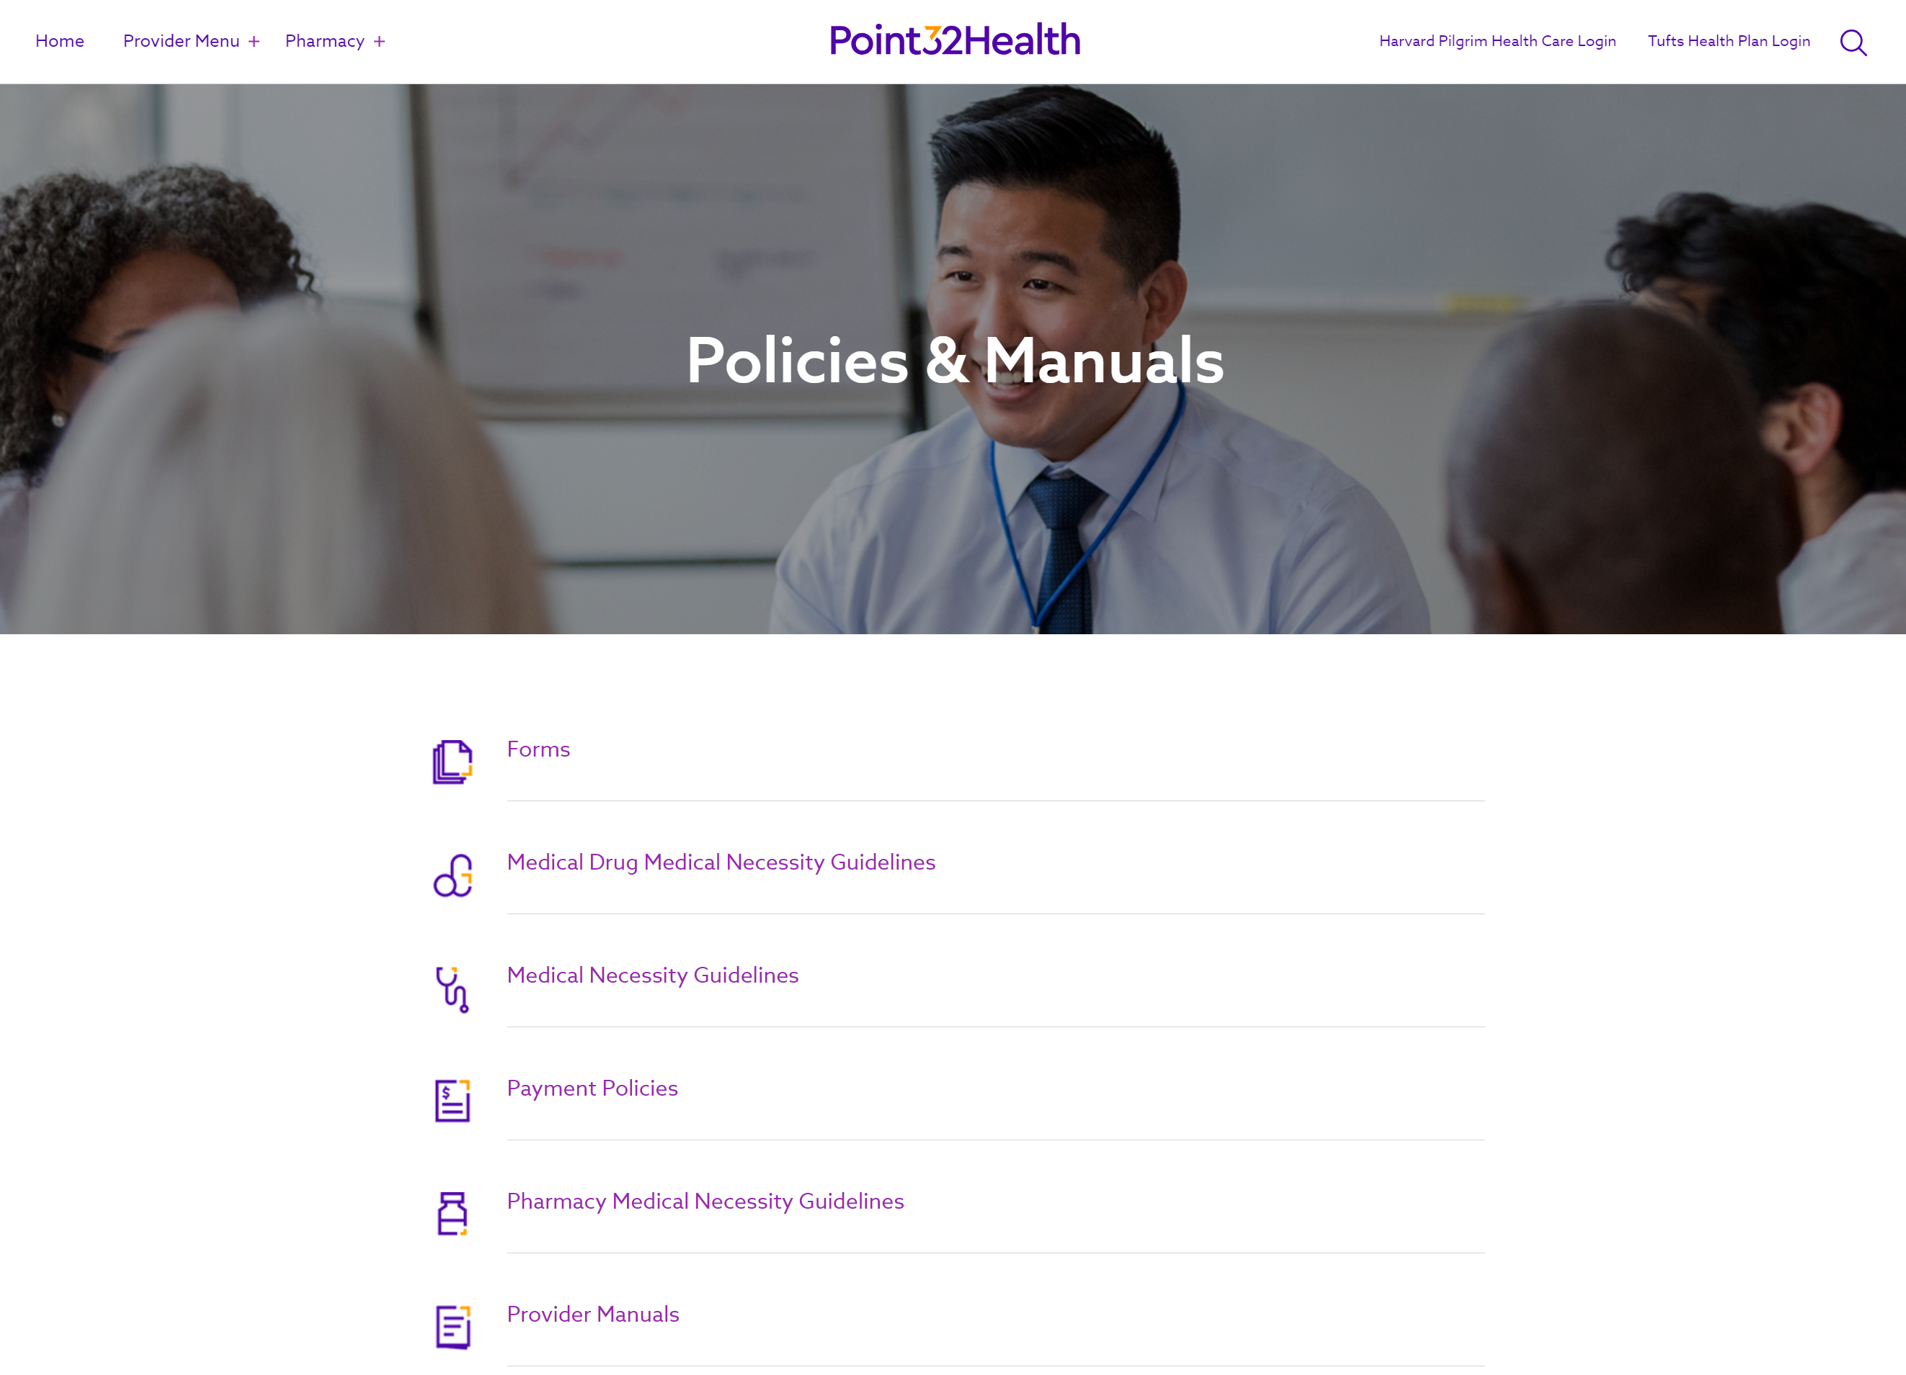
Policies & Manuals
The policies you use the most are now accessible in one place.

Slide 10

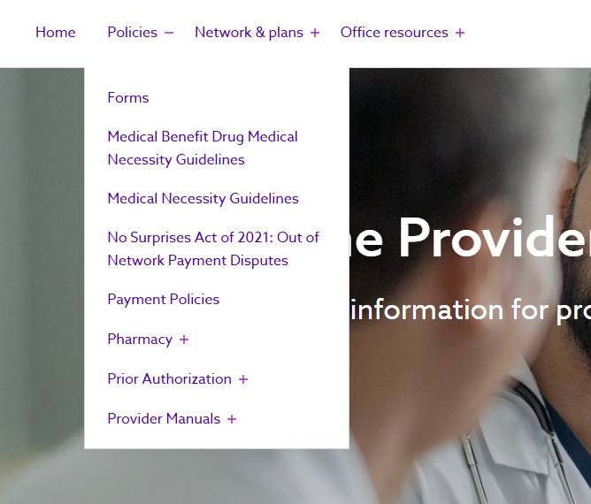
Continued website integration
Integrated page centralizes Harvard Pilgrim
and Tufts Health Plan forms.
Centralized prior authorization resources
in one place includes:
Vendor programs
Medical and pharmacy necessity guidelines
Forms

Slide 11
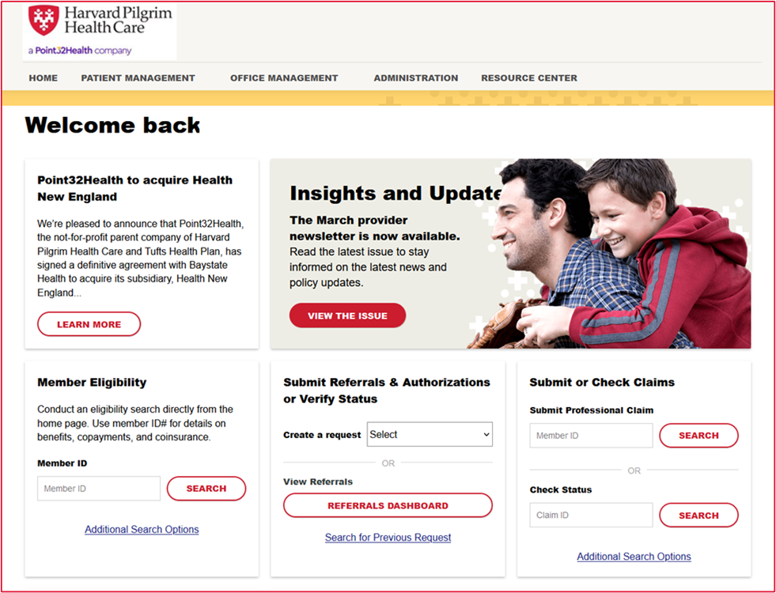
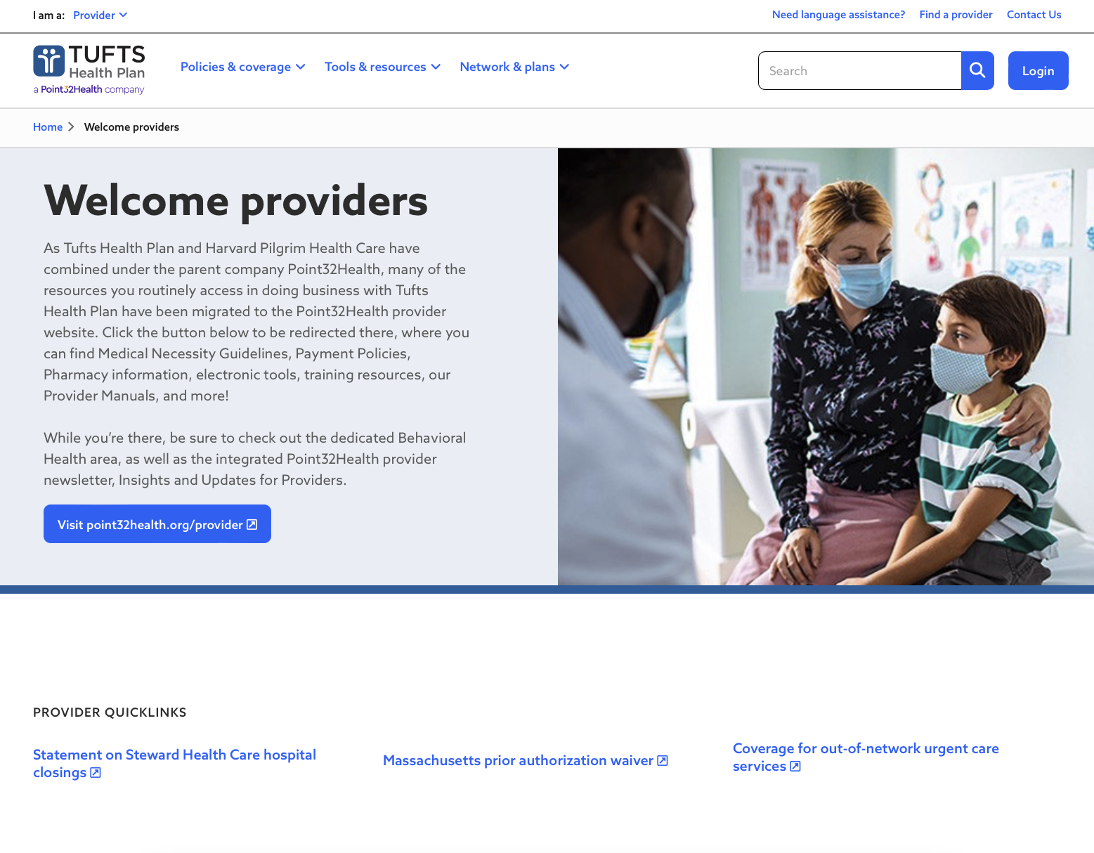
Provider Portals
Your primary tools for doing business with us
HPHConnect and the Tufts Health Plan Provider Portal gives you access to a full range of self-service transactions, including:
  Member eligibility verification
  Submitting authorizations and referrals
  Checking claims status
  And more
Access user guides on the Provider Training webpage.

Slide 12
Billing and reimbursement

Slide 13




Submitting claims
Electronic claims is the preferred method to submit claims:
Direct EDI
Clearinghouse
Provider Portal (THP claims)
The back of the member ID card includes claims submission information.
Payer ID:
Resources:
Tufts Health Plan’s Electronic Services webpage
Harvard Pilgrim’s Electronic Tools webpage
The claims sections of our Provider Manuals
Harvard Pilgrim: | 04271
Tufts Health Plan: | 04298

Slide 14

Claims disputes/appeals
Plan | Product | Address
Harvard Pilgrim | Commercial | P.O. Box 699183 Quincy, MA 02269-9183
Tufts Health Plan | Commercial | P.O. Box 251 Canton, MA 02021-0251
 | Senior Products | P.O. Box 478 Canton, MA 02021-0478
 | Public Plans | P.O. Box 524 Canton, MA 02021-0524
Available transactions on THP’s Provider Portal: submit corrected claims, dispute a denial or compensation amount, and return funds to THP.

Slide 15

Fast and secure payments
We’ve partnered with Payspan Health for electronic funds
transfers and payment advisories (explanation of payments
and electronic remittance advice/835).
      Already have Payspan?
      Log into your account and add us as a payer.
      New to Payspan?
      Contact Payspan to obtain a registration code and PIN:
        Call: 877-331-7154
        Visit: www.payspanhealth.com/RequestRegCode/

Slide 16
News & updates

Slide 17
Authorization, notification, and referral updates
Harvard Pilgrim Commercial
  Prior authorization webpage (new):
  www.point32health.org/provider/prior-authorization/
  How to submit requests:
  Fax numbers:
    Referrals: 617-509-4297
    Authorizations and notifications: 800-232-0816
Service | Provider Portal | Fax | Phone
Medical | Yes | Yes | No
Behavioral Health | Yes | Yes | Only available for certain services (as of Jan. 1, 2025)

Slide 18


Updated address for Harvard Pilgrim mail
Mail that would previously have been sent to the Harvard Pilgrim office at 1600 Crown Colony Drive in Quincy, MA should now be sent to our Point32Health corporate address:
      1 Wellness Way
      Canton, MA 02021

Slide 19
New Harvard Pilgrim product: PPO Access
Available beginning Jan. 1, 2025
Commercial PPO product
PCP is not required
In-network access to Harvard Pilgrim providers in 5 New England states and UnitedHealthcare Choice Plus network nationwide
Out-of-network access available at a higher-cost
Flex benefit option for Massachusetts members and LP (low-pay) benefit option for
New Hampshire members
Notes:
Oct newsletter: https://www.point32health.org/provider/news/new-product-offering-for-jan-1-2025/

Slide 20
Resources

Slide 21
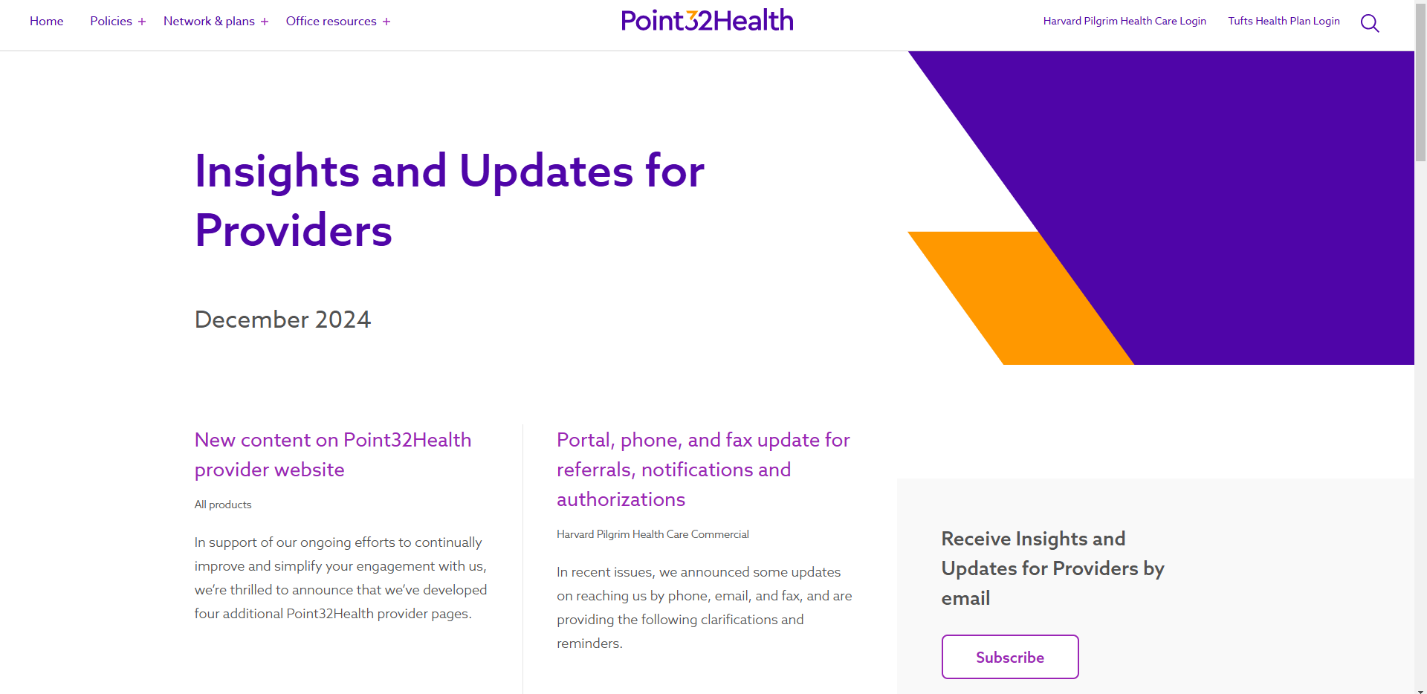
Insights and Updates for Providers
Subscribe to get our provider newsletter sent to your inbox
point32health.org/provider/news/
Our monthly provider newsletter includes:
  Policy and procedure updates
  Billing updates
  60-day advance notifications
  And more

Slide 22

Keep directory information up-to-date
How to report a change
CAQH Provider Data Portal (primary way to update your info)
https://proview.caqh.org/login
 | Harvard Pilgrim Health Care | Tufts Health Plan
Provider Information Change Form | Form: Provider Information Change Form Email: PPC@point32health.org | Form: Medical or Behavioral Health Email: provider_information_dept@point32health.org

Slide 23
Contact us
 | Harvard Pilgrim Health Care | Tufts Health Plan
Provider Services* | Commercial: 800-708-4414 | Commercial: 888-884-2404 Tufts Health Public Plans: 888-257-1985 Tufts Health Senior Products: 800-279-9022
Electronic Data Interchange (EDI) | Phone: 800-708-4414 (Option 1; then 3) Email: EDI_Team@point32health.org | Phone: 888-880-8699, ext. 54042 Email: edi_operations@point32health.org
Technical Inquiries | Phone: 800-708-4414 (Option 1; then 6) Email: Provider_eBusiness_Services@ point32health.org | Email: Tufts_Health_Plan_Provider_ Technical_Support@point32health.org
*The Provider Services email was discontinued as of Oct. 1, 2024.

Slide 24
Q & A

